Slide 1
Lecture 14 Newton Mechanics Inertial properties,Generalized Coordinates
Ruzena Bajcsy
Fall 2018

Slide 2
Introduction

Slide 3
Dynamics

Slide 4
Newton Dynamics

Slide 5
Mechanical system, describing Geometry, center of mass ,velocity and forces

Slide 6
Explanation of Notation

Slide 7
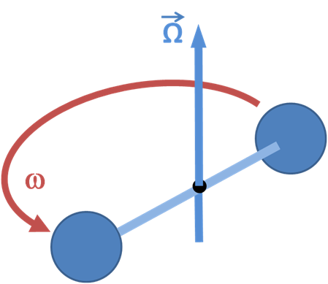
Two spheres tied with a string and rotating at angular rate omega. Because of the rotation, the string is under tension

Slide 8
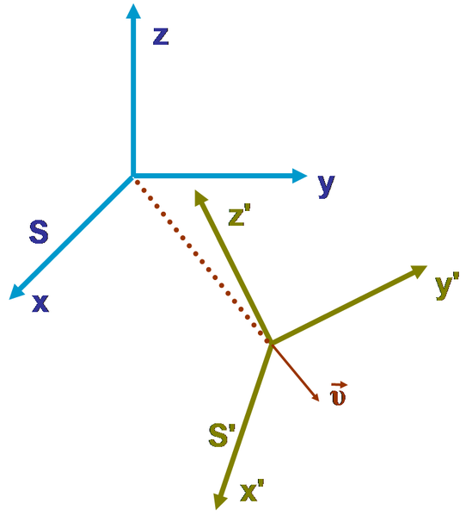
In Newtonian Mechanics, an Inertial Frame of reference is one in which newton’s first law of motion is valid. The body is not a subject to forces and it will move in straight line at constant speed

Slide 9
Newton First Law of Inertia
Hence, with respect to an inertial frame, an object or body accelerates only when a physical force is applied, and (following Newton's first law of motion), in the absence of a net force, a body at rest will remain at rest and a body in motion will continue to move uniformly—that is, in a straight line and at constant speed.
Mass can be considered a measure of body’s inertia. The mass of the body is the volume integral of the mass density.
The we can define a symmetric matrix I, called Inertia tensor of the object expressed in the body frame .

Slide 10
Inertia Tensor

Slide 11
Computing Inertia tensor

Slide 12
Inertia under frame transformation

Slide 13
Euler Equations
Euler’s equation describes the rotation (Omega) of a rigid body, using a rotating reference frame with its axes fixed to the body and parallel to the body’s principal axes of inertia (Inertia tensor) and generating torque M.

Slide 14
F is a force, N is a torque, M is Inertia tensor, Omega angular velocity, v linear velocity, m is mass

Slide 15
Newton- Euler Equation.

Slide 16
Generalized Coordinates

